Slide 1






DSG
CANSAT
PROJECT
DEEP.SOUND.GALACTIC

Slide 2


CONTENT
01
02
03
04
The History of Cansat
Goals
ITEC part
SIN part

Slide 3



HISTORY OF CANSAT
We are in a spaceship called “Nostromo” and we just woke up and saw an critical emergency about our power supply affecting our Elektron Oxygen Generator, we must quickly land and we need to make sure that the planete is sure
We have to send a Cansat and prepares for a reconnaissance where it will have to land with a parachute and measure multiples informations

Slide 4



GOALS AND OBJECTIVES
01
Get the pressure, temperature and the humidity from the air and send them every second to a receiver
02
Send a signal to our computer with an antenna. If there’s local form of life they can send us a message too
03
Know if there’s a danger. If there’s one, we will scare it with a loud sound coming from a buzzer.

Slide 5
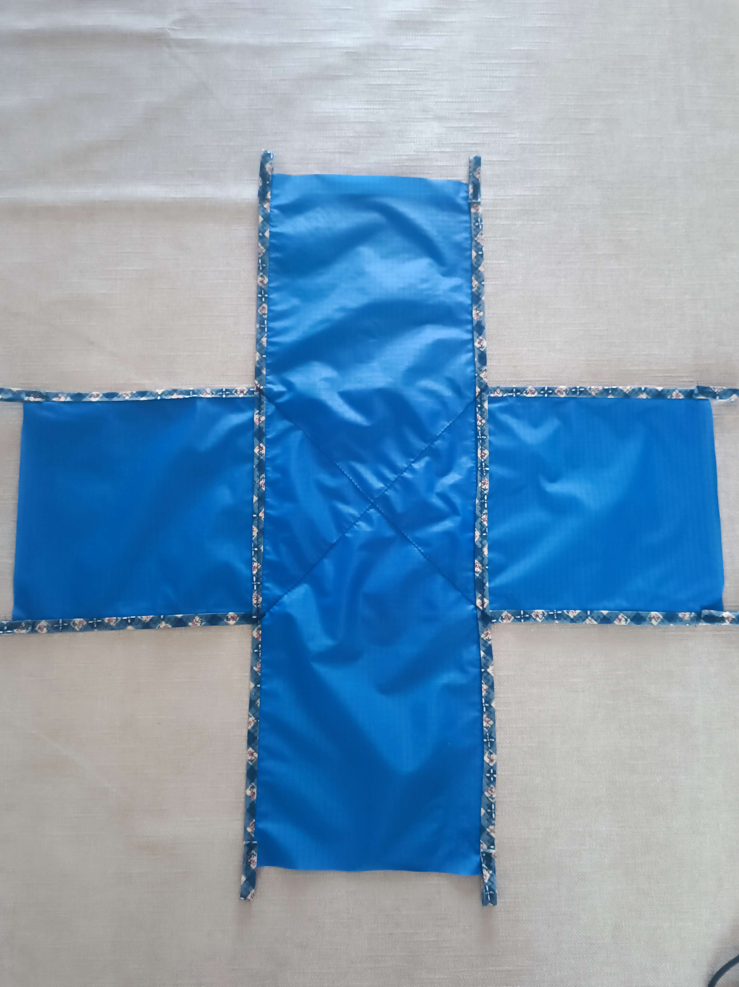
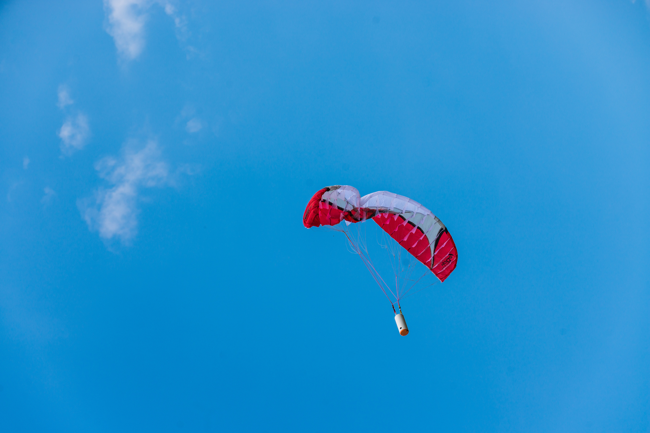
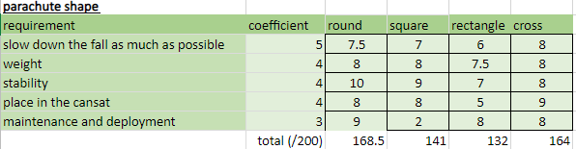
PARACHUTE DEVELOPMENT
Matrice de choix = preference matrix​
Résistance au vents = wind resistance​
5 m/s < descent speed < 12 m/s
Notes:
maxi : 120s / si piloté : 170s
5 m/s < Vitesse de descente < 12 m/s
résistance du parachute: 5N
if piloted

Slide 6
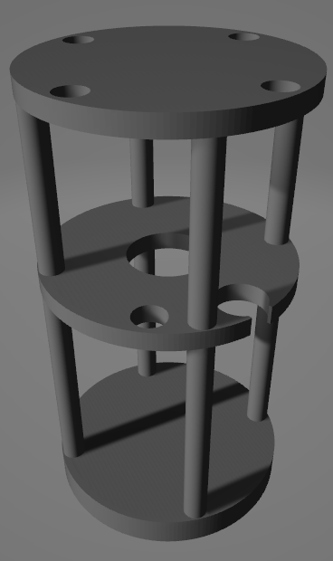

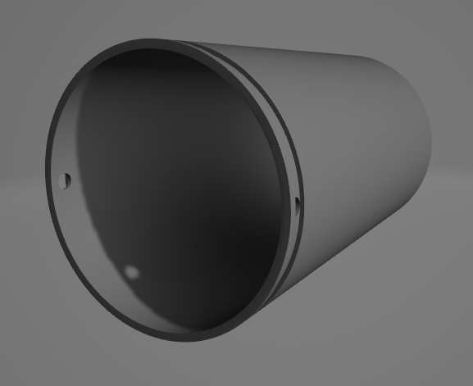
INSIDE THE CANSAT
We will have to optimize every cubic centimeters of spaces that is available
because there is things such as :
Sensors
limited space (33cl)
a battery
impact protections
weight management
cable management

Slide 7
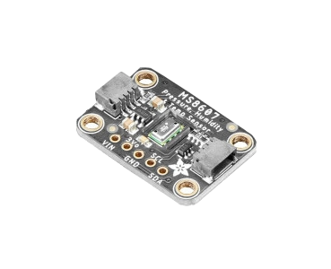
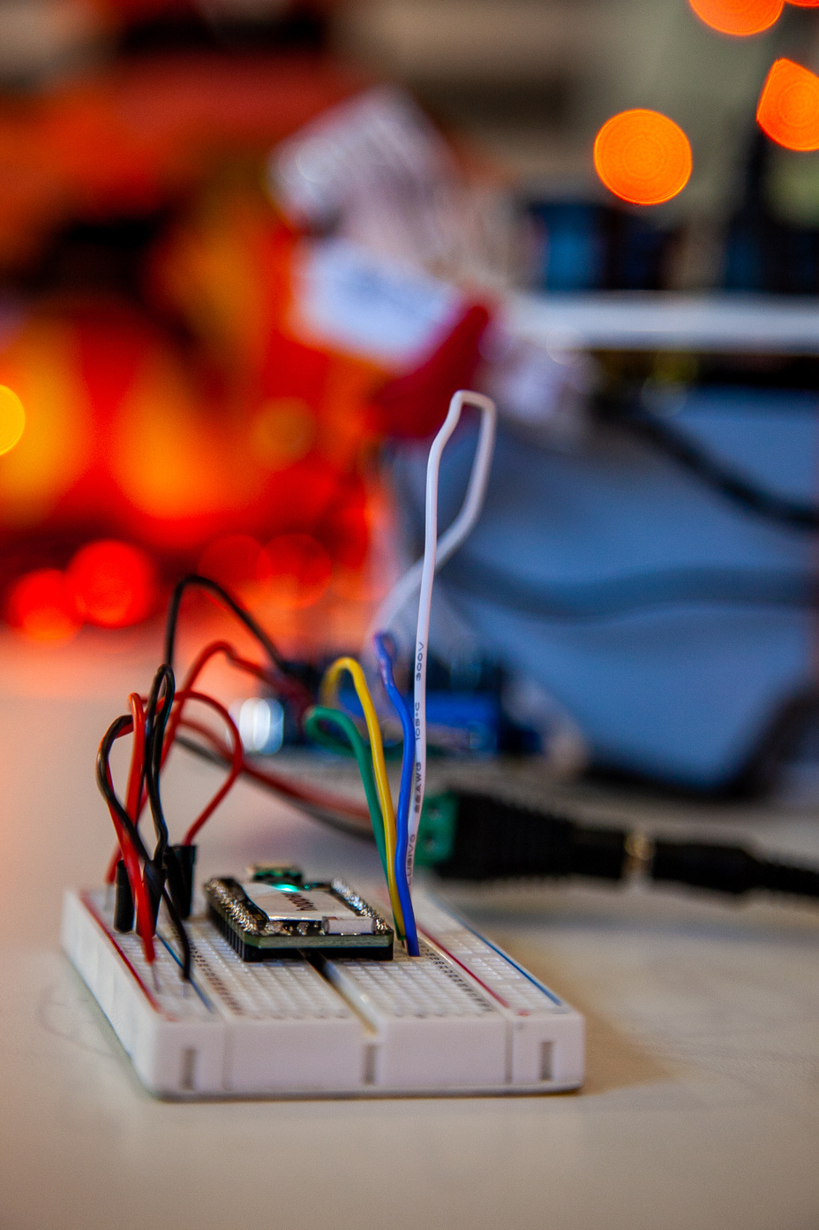
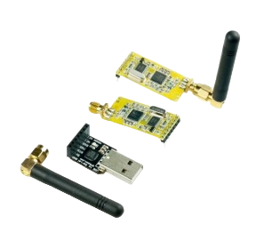
SENSORS
Taking pressure, humidity and temperature using the MS8607 sensor​
Using the APC220 to send/receive a signal​ and the data
Using a buzzer to send sound​
Controlling everything with an Arduino Card

Slide 8
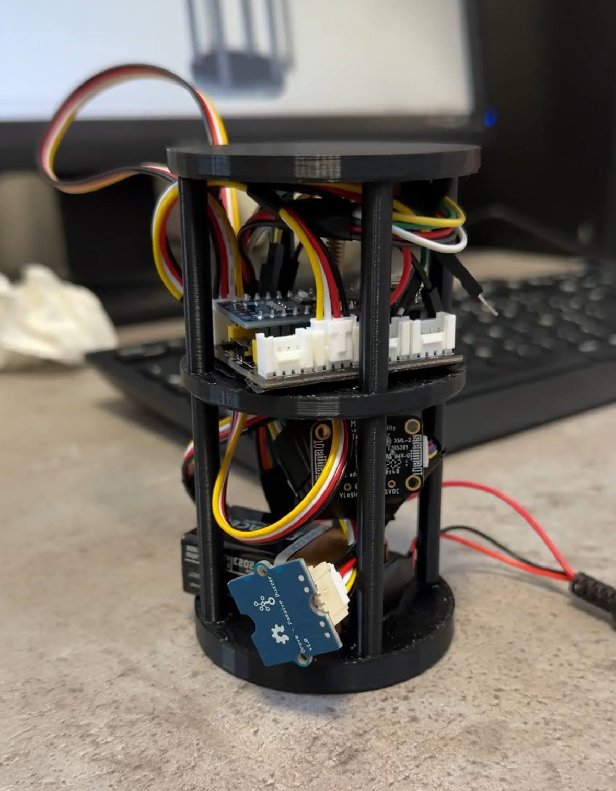
SENSORS
At first we wanted to use an SD card to save our data. Work fine until we started compiling every program together We decided to change our program and use antenna instead of the SD card to transfer data to our computer

Slide 9
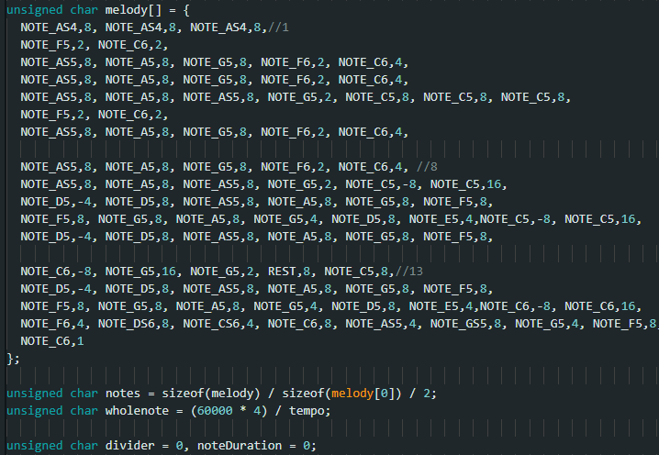
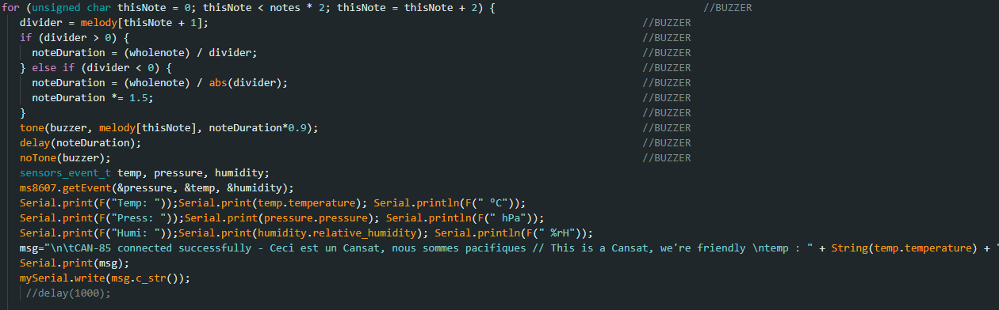
SENSORS
In this program, at first, we make a sound with the buzzer, then we get data from the sensor, and we send them to our computer through the antenna and at the same time we send a message to our computer so stay in contact with our Cansat.

Slide 10
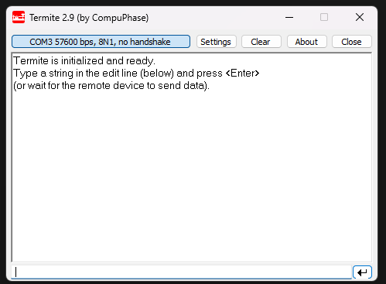
SENSORS
Here is the software we’re using to stay in contact everytime with our Cansat. We receive every data and message on it.
CAN-85 connected successfully - Ceci est un Cansat, nous sommes pacifiques // This is a Cansat, we're friendly Press 983 hPa Temp 19,8 °C Humi 68,2 %rH
CAN-85 connected successfully - Ceci est un Cansat, nous sommes pacifiques // This is a Cansat, we're friendly Press 983 hPa Temp 19,8 °C Humi 68,2 %rH

Slide 11

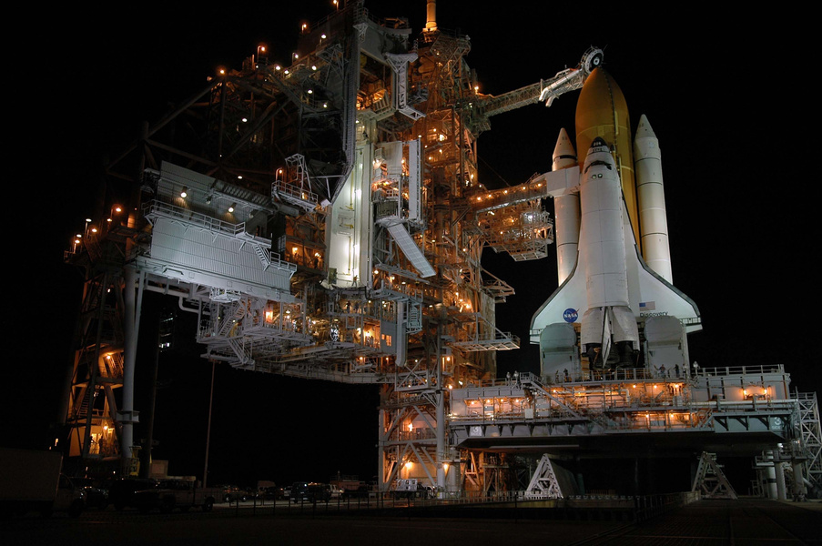
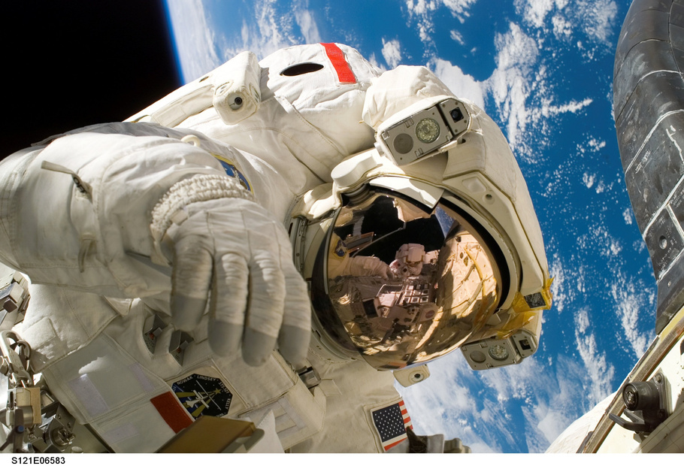
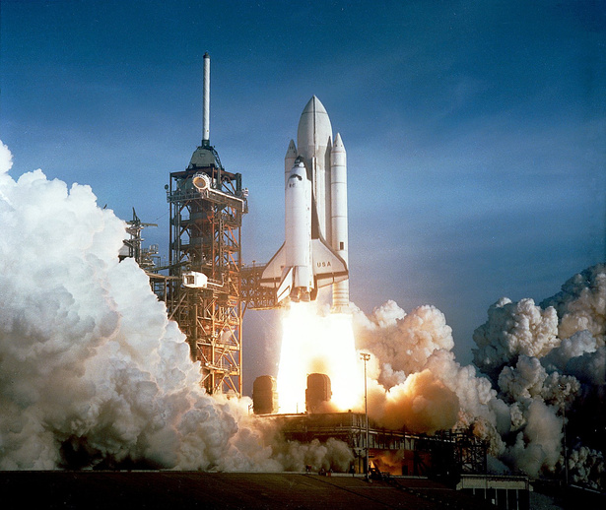

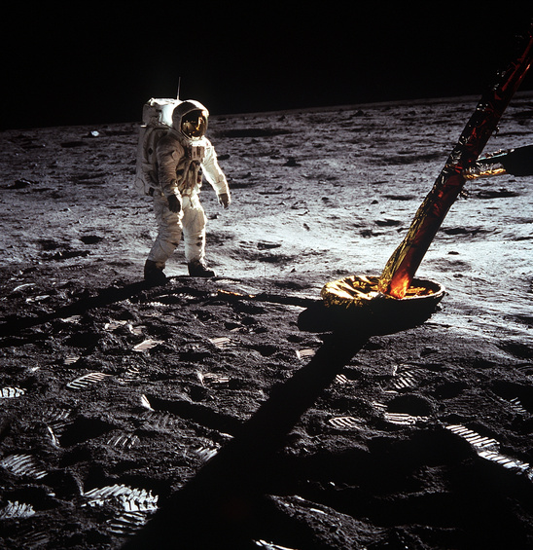
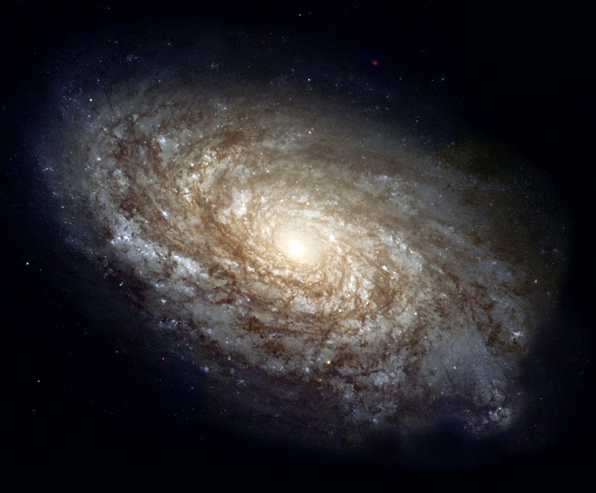
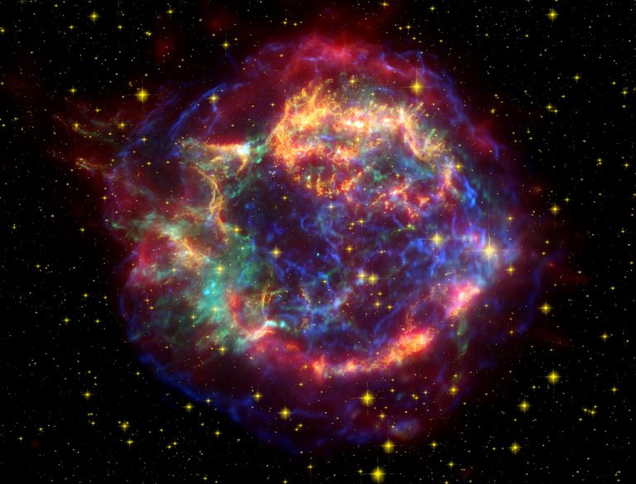
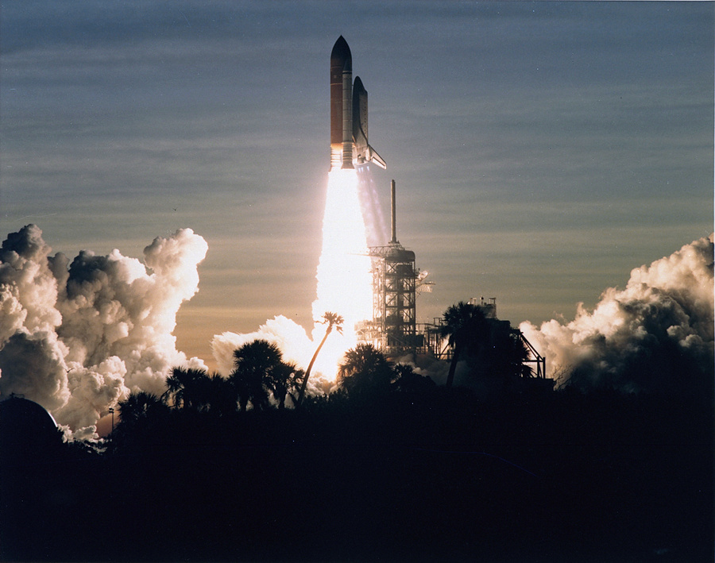
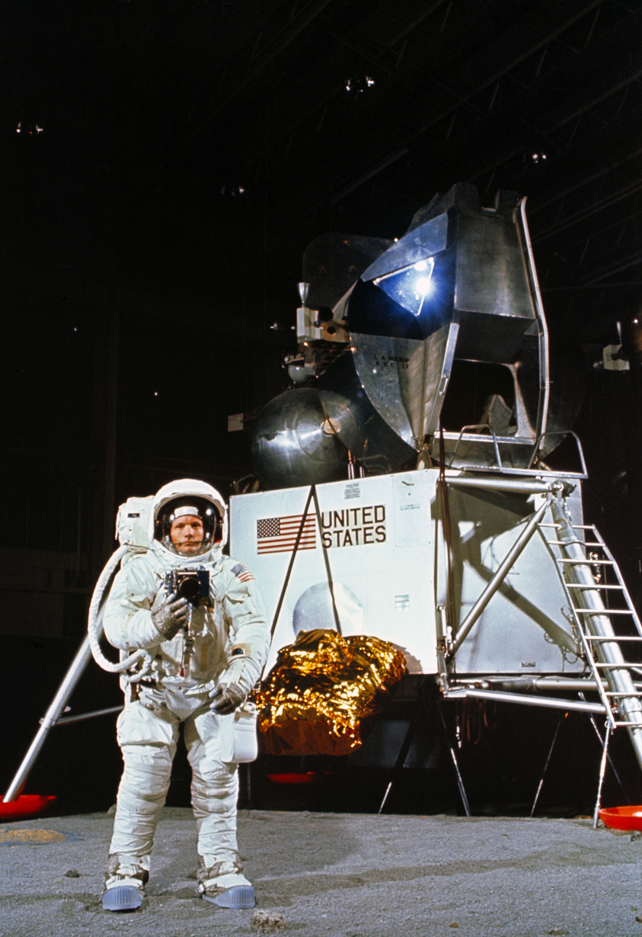
DSG TEAM
THANK'S FOR WATCHING

